Slide 1
Domestic Violence Incident Report
State of Nevada
DV Report
How to Enter Data into the Monthly Domestic Violence Report
Notes:
The following presentation will show you how to enter data into your monthly Domestic Violence Report.

Slide 2
Table of Contents
Getting Started
Date of Offenses
Offender Information
Victim Information
Victim Relationship to Offender
Arrestee Information
Mitigating Circumstances for Primary Aggressor Not Being Arrested
Other Persons Involved Arrest Information
General Information
Save and Submit
Notes:
The table of contents show us what we will discuss during this presentation. You can listen to the whole presentation or skip ahead to any of the sections listed.

Slide 3
Getting Started
Open up the Domestic Violence Report.
Click on “Enable Editing”
Fill out agency and month/year fields.
Click “Enable Editing”
Notes:
To get started open up the Domestic Violence Report and click on enable editing. Fill in the agency and month/year fields with your agency name and the month/year this report is for.

Slide 4
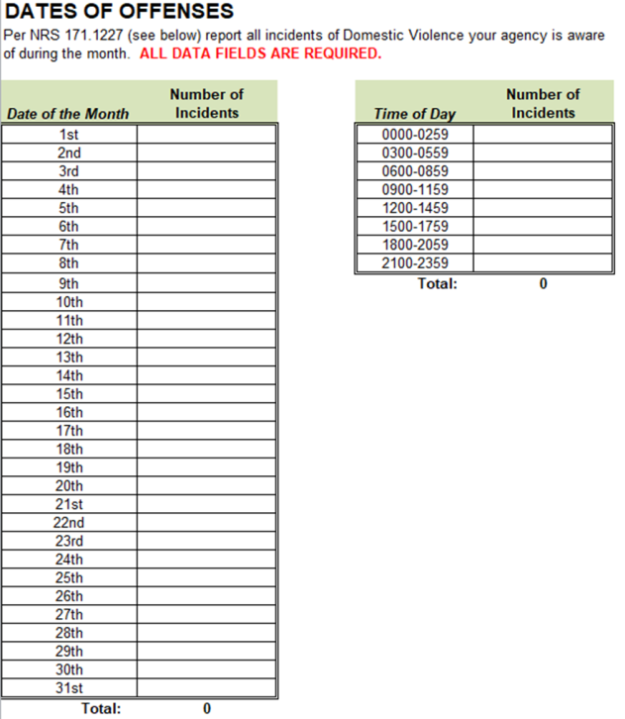
Date of Offenses
Per NRS 171.1227 report all incidents that your agency is aware of.
Report incidents by day of the month and time of day.
Number of incidents should be equal.
Time of Day
Date of Month
Notes:
Report all incidents that your agency is aware of. Report the day of the month and time of day for all incidents that occurred during the month. Totals for each should be equal.

Slide 5
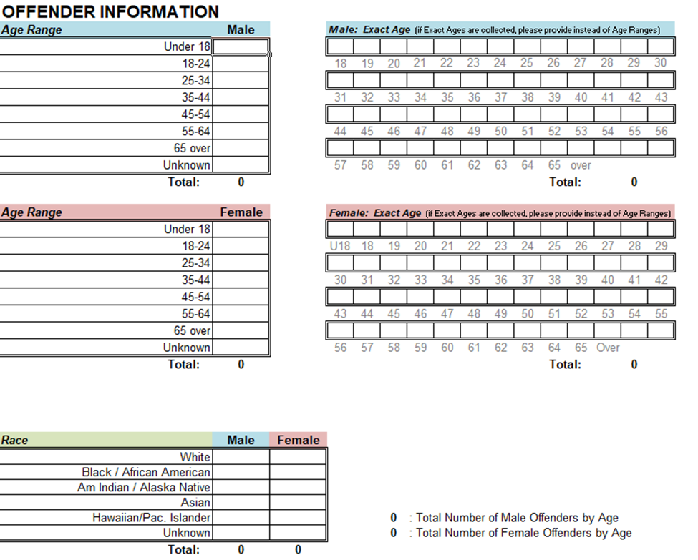
Offender Information
Select the age range for both male and female offenders.
Then select the race for male and female offenders.
“Age” & “Race” totals should be equal.
“Age”
“Race”
Notes:
For offenders enter their age and race into the appropriate fields. Information is needed for both male and female offenders.

Slide 6
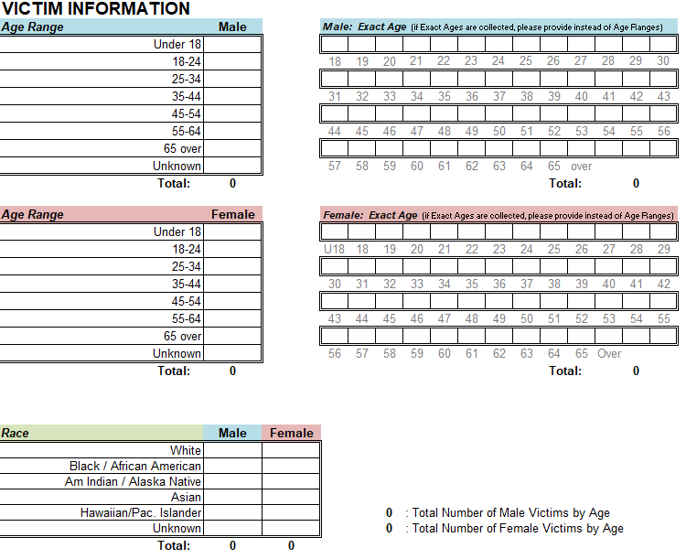
Victim Information
Select the age range for both male and female victims.
Then select the race for male and female victims.
“Age” & “Race” totals should be equal.
Age
Race
Notes:
Similar to offender information victim information is needed. Input age and race into appropriate fields.

Slide 7
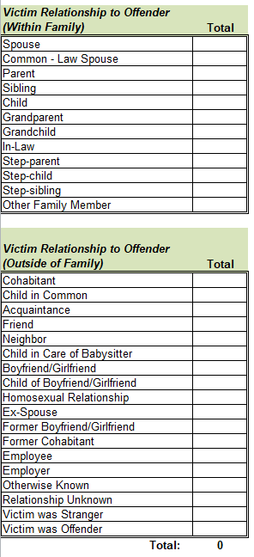
Victim Relationship to Offender
Select the victim relationship to offender.
“Victim Relationship” & total number of victims reported should be equal.
Victim Relationship to Offender
Notes:
Select the victim relationship to offender. Pictured is all the ways the victim can have a relationship to an offender. The total number of victims should match the total amount of relationships reported.

Slide 8
Arrestee Information
“Primary Aggressors Arrest Information”
Separated by male and female.
Offender was either arrested or not arrested.
Arrested and not arrested total should equal total amount of offenders.
“Primary Aggressors Arrest” total should equal “Number of Incidents Reported”
Notes:
Arrestee Information. First we will start with “Primary Aggressors Arrest Information” As you can see the offender was either arrested or not arrested. The totals should equal the amount of offenders that were reported earlier on in the report. Also, “Primary Aggressors Arrest” total should equal “Number of Incidents Reported”

Slide 9
Mitigating Circumstances for Primary Aggressor Not Being Arrested
“Mitigating Circumstances for Primary Aggressor Not Arrested”
Report reason why aggressor was not arrested.
6 reasons
Aggressor undetermined
Gone upon arrival
No evidence of injury
Not reported within 24 hours
Other
Unknown
“Mitigating Circumstances” total should equal total number of “Primary Aggressors Not Arrested”
Notes:
Second, “Mitigating Circumstances for Primary Aggressor Not Arrested.” For those that were not arrested. Report Reason why aggressor was not arrested. 6 reasons. “Mitigating Circumstances” total should equal total number of “Primary Aggressors Not Arrested”

Slide 10
Other Persons Involved Arrest Information
The last part of the Arrestee Information you will see is “Other Persons Involved Arrest Information” which has two parts:
Other Persons Involved Arrested
Male & Female
Other Persons Involved Not Arrested
Male & Female
Notes:
Other Persons Involved Arrest Information is the last section of the Arrestee Information. This section has two parts Other Persons Involved Arrested and Other Persons Involved Not Arrested
. Fill these sections appropriately if it applies.

Slide 11
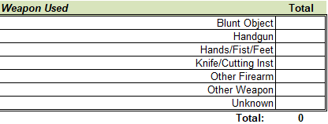
General Information
Report “Weapon Used” and “Additional Information Regarding Incident”
Notes:
General Information. Report “Weapon Used” and “Additional Information Regarding Incident” if it applies to your monthly report

Slide 12
Save & Submit
Click File, Save As to save report.
Send Report to:
ucr@dps.state.nv.us
Questions?
UCR Program @ 775.684.6241
Notes:
Click File, Save As to save report. Once saved send your report and if you have any questions contact the UCR Program.

