Slide 1
Crimes Committed Against Older Persons
State of Nevada
Elderly Report
Understanding the Elderly Report Form

Slide 2
Table of Contents
Getting Started
What Gets Reported?
Save & Submit
Abuse
Neglect
Exploitation
Isolation
Abandonment

Slide 3
Getting Started
Open up the Elderly Report.
Click on “Enable Editing”
Fill out agency and month/year fields.
Click “Enable Editing”
Fill Sections Out

Slide 4
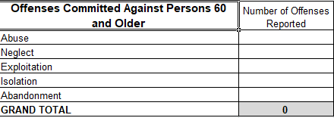
What Gets Reported?
Offenses committed against persons 60 and older.
5 different offense categories:
Abuse
Neglect
Exploitation
Isolation
Abandonment
Offense Categories

Slide 5
Save & Submit
Click File, Save As to save report.
Send report to:
ucr@dps.state.nv.us
Questions?
UCR Program @ 775.684.6241

Slide 6
Abuse

Slide 7
Neglect

Slide 8
Exploitation

Slide 9
Isolation

Slide 10
Abandonment

