Slide 1
Uniform Crime Reporting
State of Nevada
UCR Workbook
How to Enter Data into the UCR Workbook

Slide 2
Table of Contents
Enable Editing
Enable Content
Agency Information Tab
All Reports Options
Arson Only Options
Start New Workbook
Save Document
Return A
Return A Supplement
LEOKA
Arrest – Juvenile
Arrest – Adult
Arson
SHR – Homicide/Manslaughter
Hate Crimes
Police Employees
Human Trafficking
Cargo Thefts
Save & Submit

Slide 3
Enable Editing
Click “Enable Editing”

Slide 4
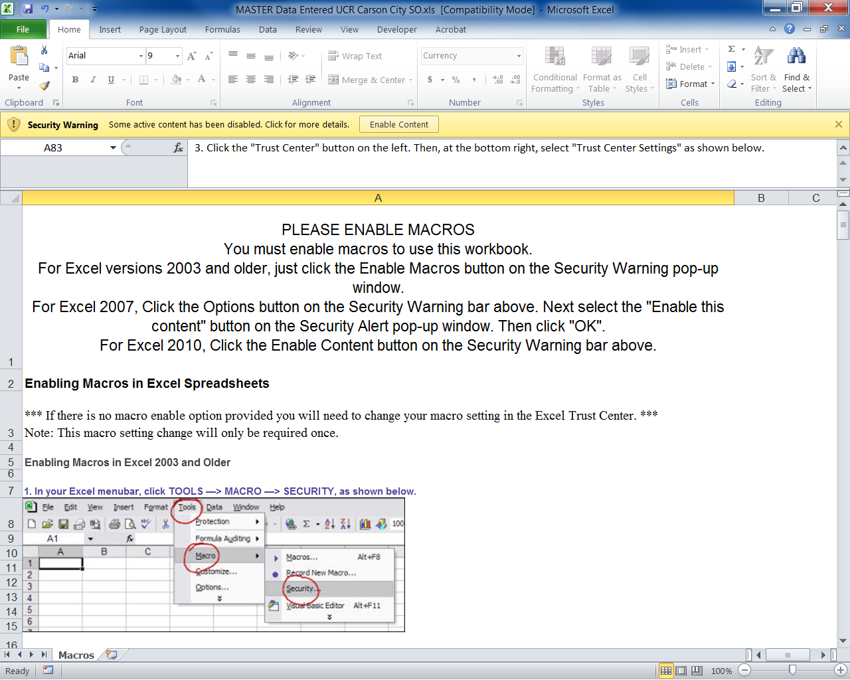
Enable Content
Click “Enable Content”

Slide 5
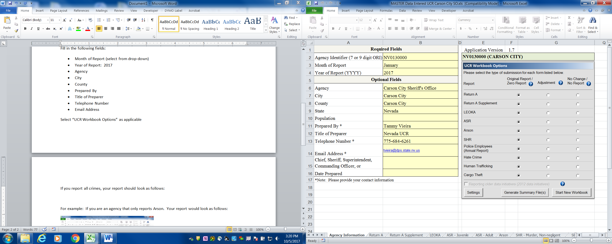
Agency Information Tab
Fill in the following fields:
Month of Report (select from drop-down)
Year of Report: Agency
City
County
Prepared By
Title of Preparer
Telephone Number
Email Address
Select “UCR Workbook Options” as applicable

Slide 6
All Reports Options
If you report all crimes, your “UCR Workbook Options” should look as follows.
“Original/Zero” Report buttons selected

Slide 7
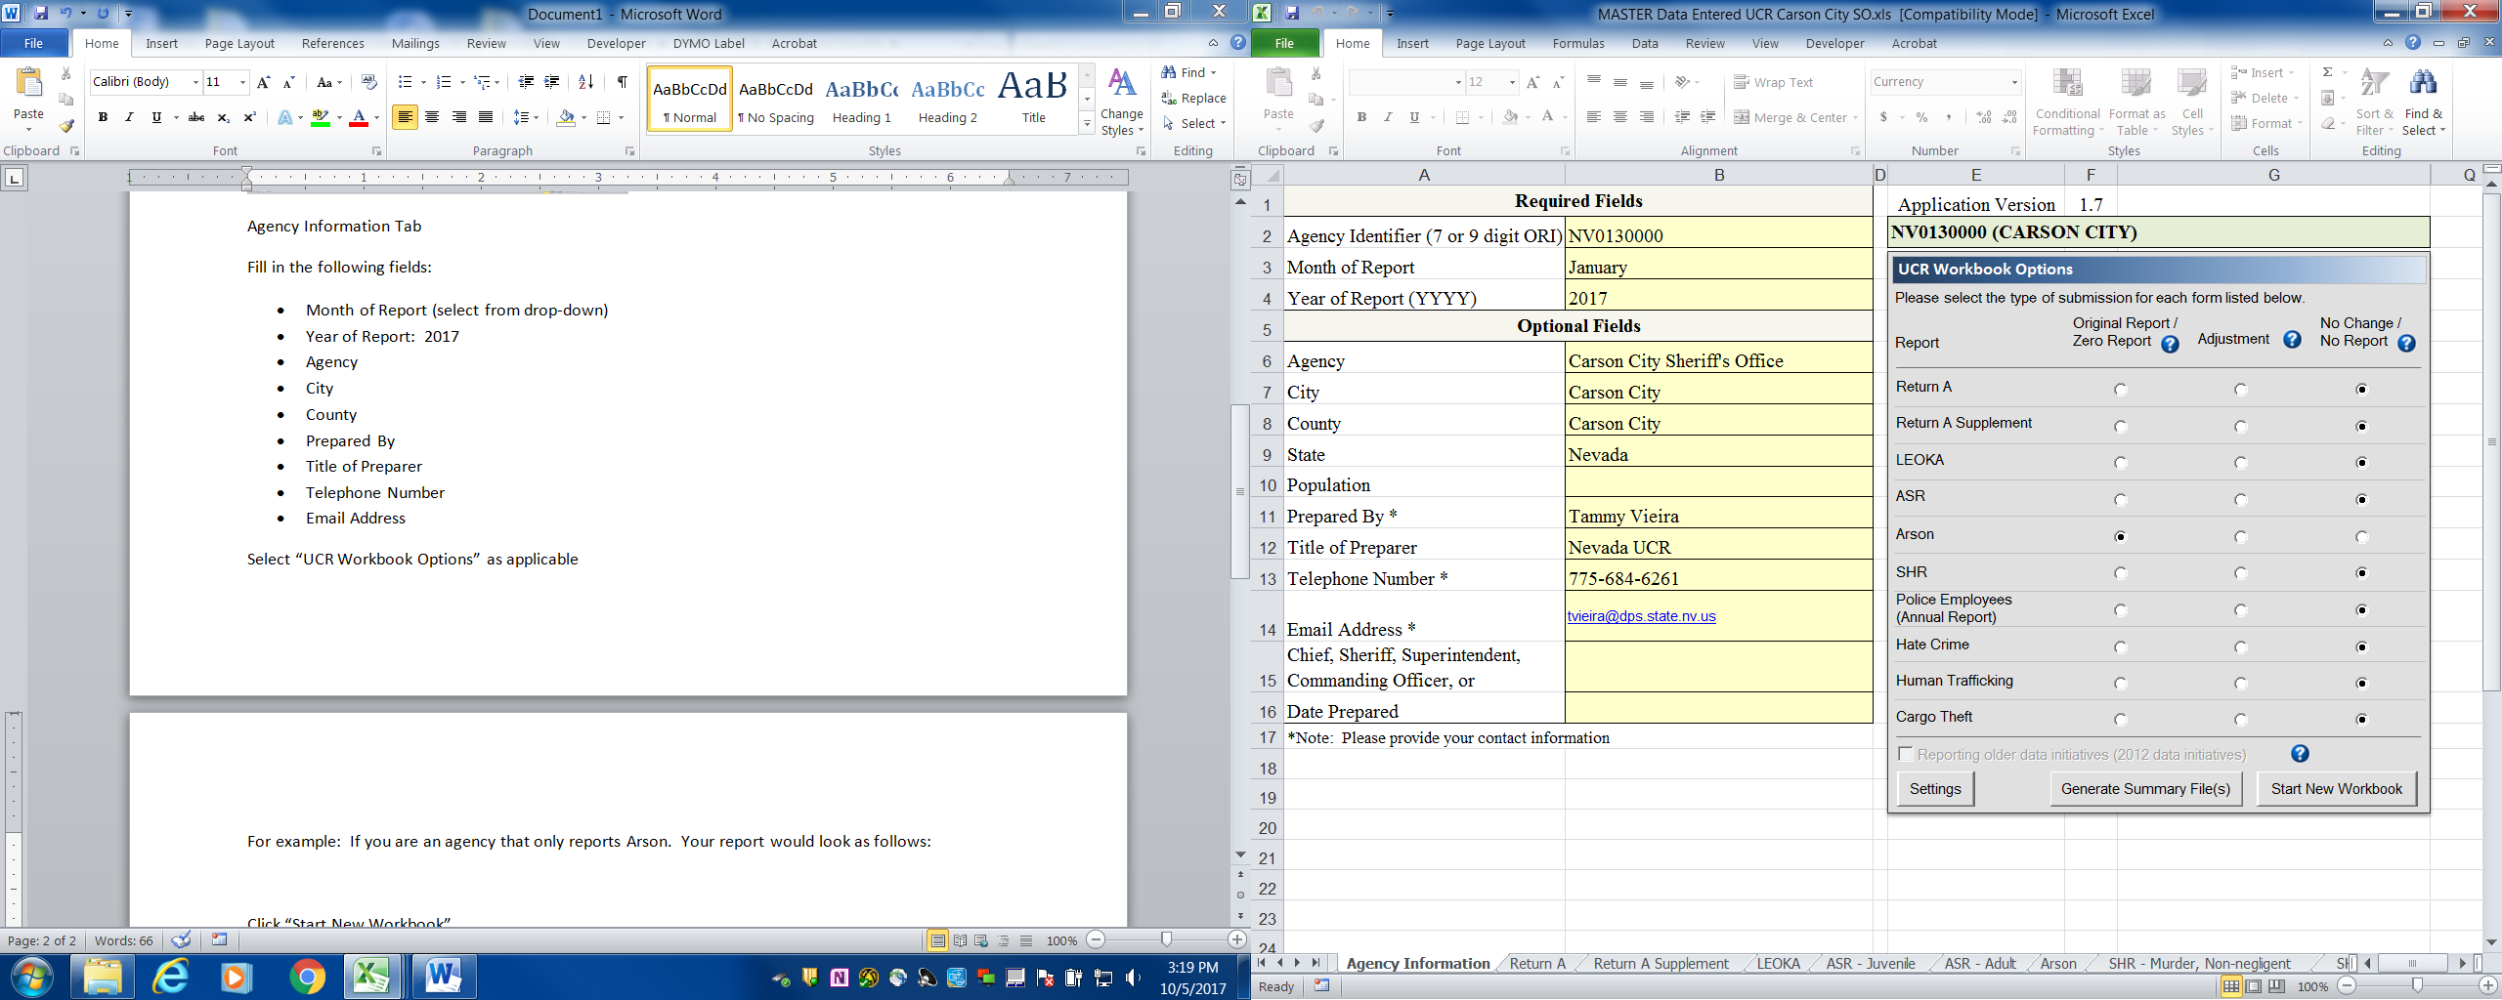
Arson Only Options
For example: If you are an agency that only reports Arson.
Your “UCR Workbook Options” would look as follows.
“Original/Zero” Report button selected for Arson Only
“No Change/No Report” selected for all reports but Arson

Slide 8
Start New Workbook
Click “Start New Workbook”

Slide 9
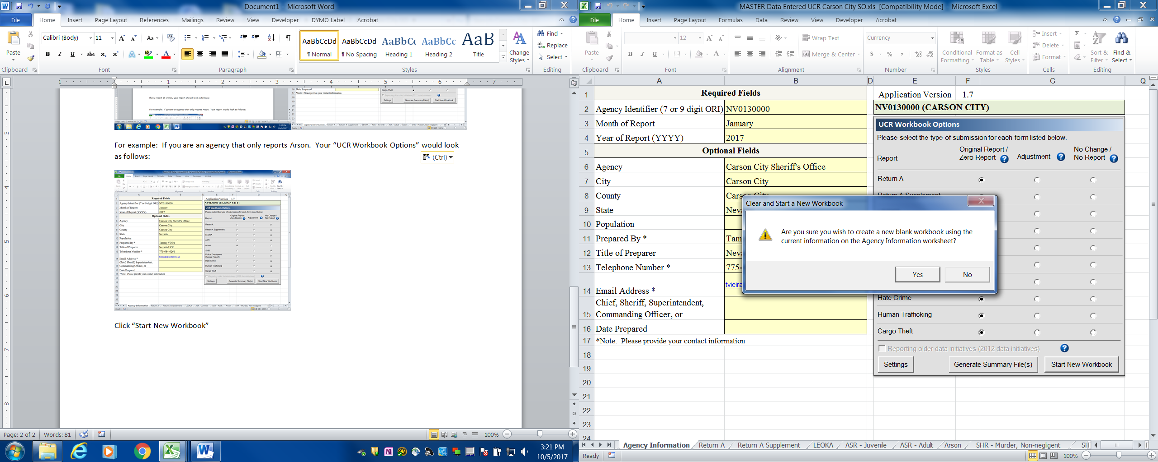
Create Blank Workbook
Click “Yes”

Slide 10
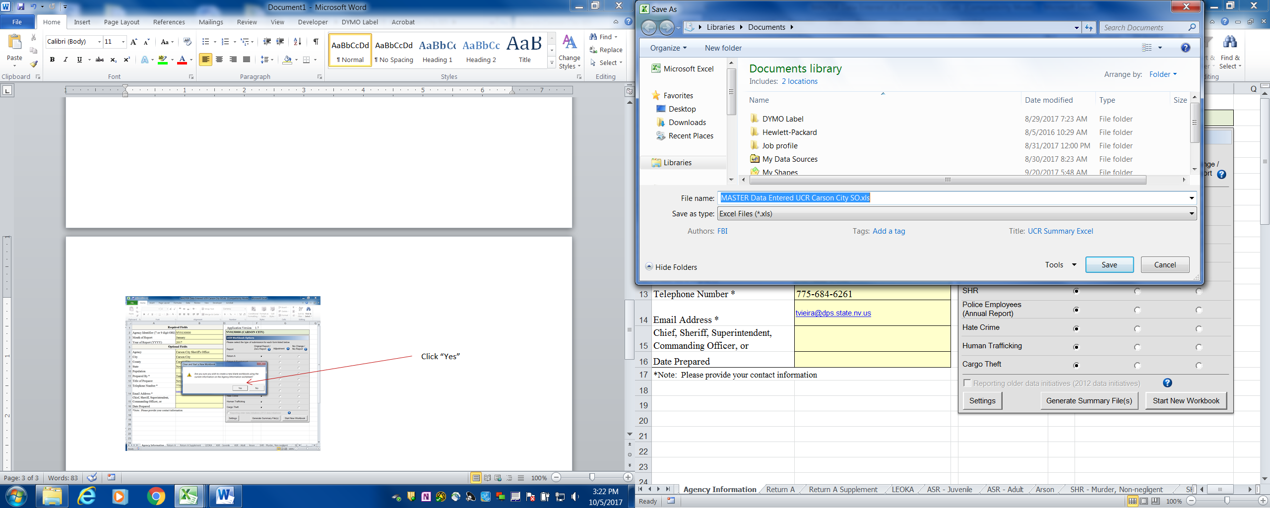
Save Document
Name the File, Save
Suggestion: (Month) Data Entered UCR (Agency Name)

Slide 11
Return A
Enter Data into Yellow Cells.
White Cells will automatically calculate.

Slide 12
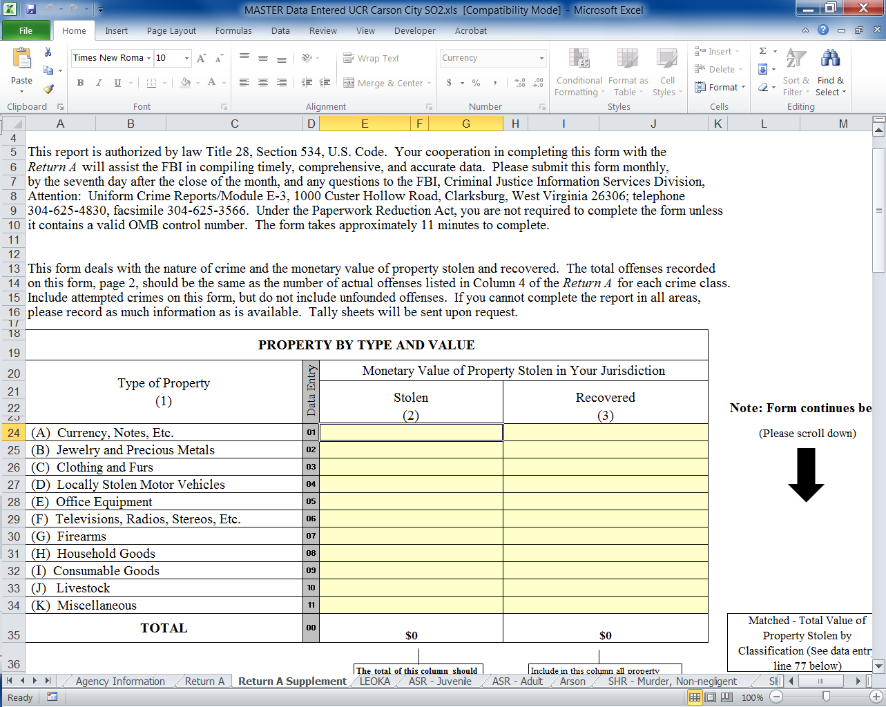
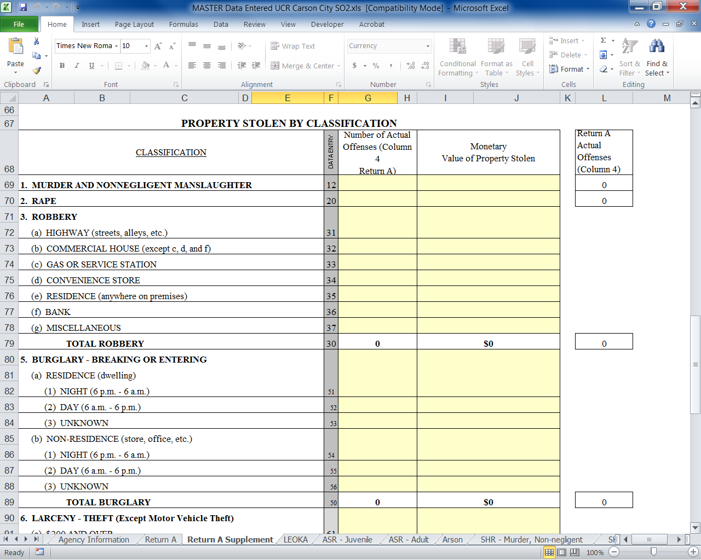
Return A Supplement
Total Offenses (Return A Supplement) = Total Number of Actual Offenses (Column 4 of the Return A) for each crime class.
Total Larceny (line 94: Data Entry #60) = Total Larcenies (line 108 :Data Entry #80) Number of Offenses and Property Value must be equal.

Slide 13
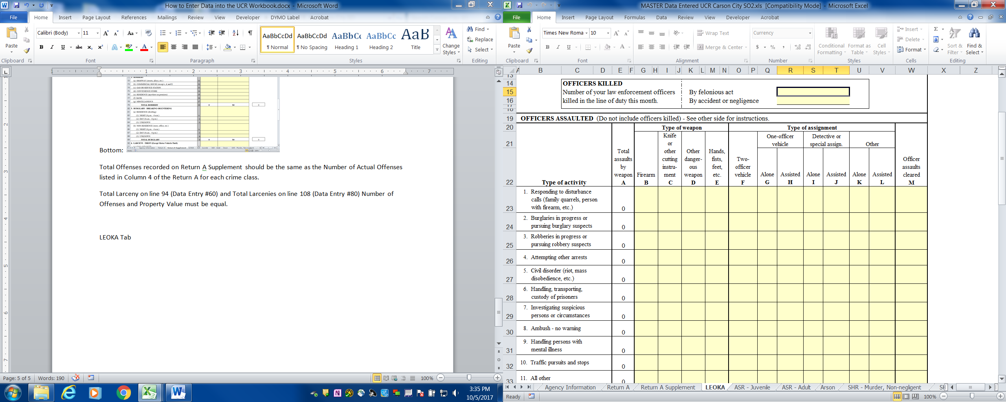
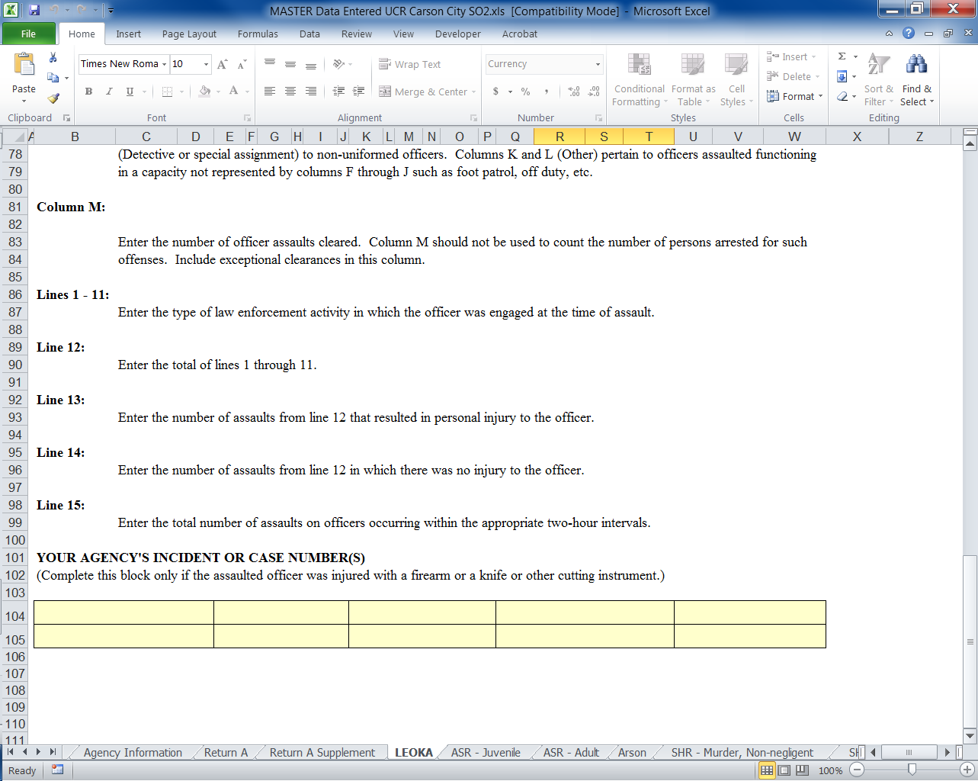
LEOKA
Enter Data into Yellow Cells.
White Cells will automatically calculate.

Slide 14
ASR - Juvenile
There are 2 sections to this Worksheet:
“Police Disposition of Juveniles” and
“Age, Sex, Race, and Ethnicity of Persons Arrested, under 18 years of age”
Enter Data into Yellow Cells. White/Grey Cells will automatically calculate.
Total Number of Male/Female Arrests = Total Number of Male/Female Race
Total Number of Male/Female Arrests = Total Number of Male/Female Ethnicity

Slide 15
ASR - Adult
Enter Data into Yellow Cells.
White/Grey Cells will automatically calculate.
Total Number of Male/Female Arrests = Total Number of Male/Female Race
Total Number of Male/Female Arrests = Total Number of Male/Female Ethnicity

Slide 16
Arson
Enter Data into Yellow Cells.
White Cells will automatically calculate.
Note: Zeros will disappear in “Estimated Value of Property Damage” column if there are no amounts given.

Slide 17
SHR – Murder / Negligent Manslaughter
Click “Add New Incident”
Use the dropdowns to enter the requested information
Once you click “Finish” the information will automatically enter into the form.
Verify information was entered accurately.

Slide 18
Hate Crimes
Click “Add New Incident”

Slide 19
Police Employees
All Employee counts as of October 31st need to be submitted in your OCTOBER report.
Enter Data into Yellow Cells.
White Cells will automatically calculate.
Please make sure to calculate the percentage change from last year so that you input an explanation if the change is more than 10%.
Formula for Percentage change: $\frac{This Year Total−Last Year Total}{Last Year Total}∗100\%$

Slide 20
Hate Crimes
Click “Save Changes” when entry is complete
Enter Data into Yellow Cells.
White Cells will automatically calculate.
Use the dropdowns to enter the requested information

Slide 21
Cargo Theft
Click “Add New Incident”

Slide 22
Cargo Theft
Enter Data into Yellow Cells.
White Cells will automatically calculate.
Use the dropdowns to enter the requested information

Slide 23
Human Trafficking
Enter Data into Yellow Cells.
White Cells will automatically calculate.

Slide 24
Save & Submit
Send completed UCR Form to UCR@dps.state.nv.us
Questions?
Call Tammy Vieira @ 775.684.6241
Call Laurel Brock @ 775.684.6244
NOTE: UCR Workbooks are due to the State of Nevada 15 days after the close of the month.

