Slide 1
Upload Files to the State’s File System
State of Nevada
Uniform Crime Reporting

Slide 2
Contents
Agency & State Access
How to Login to FTP site
Username and Password
Open an Agency’s Folder
Upload a File
How to View Contents of File
Download a File
State Access Only
How to Access Administration Screen
Add New User
Create New User Profile
Create a New Folder
Get to Folder Permissions
Edit Folder Permissions
Switch from Administration View to Folder View

Slide 3
How to Use the State FTP Server
Agency and State Access

Slide 4
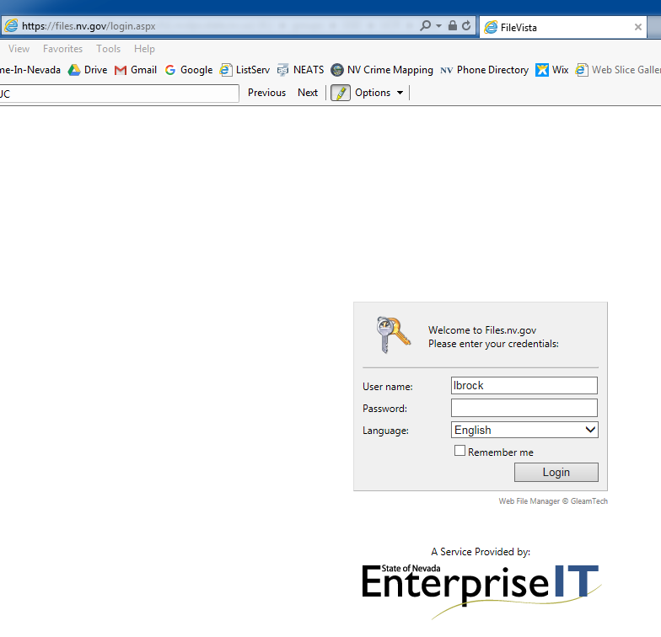
Login to FTP Site
Go to https://files.nv.gov/login.aspx

Slide 5
Username & Password
Enter your Username and Password
* Email will be sent out to you with your specific agency’s username and password
Default Password: “password” (no caps)
Click “Login”

Slide 6
Open your Agency’s Folder to Upload
1. Double-Click your Agencies Folder
2. Click the “Upload” Arrow

Slide 7
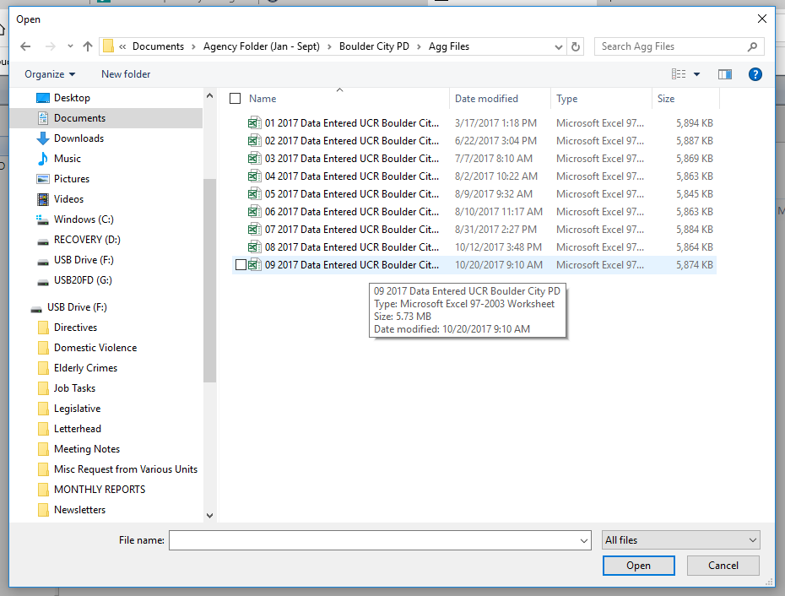
Upload your File
5. Click “Upload”
3. Click “Add”
4. Select the File

Slide 8
How to View Folder Contents
Double-Click File

Slide 9
How to Download a File
Select the File
Click the blue “Download” Arrow
The file should be in the “Downloads” File on your computer

Slide 10
ADMINISTRATION ONLY
State Access Only

Slide 11
Administration Screen
Click “Your Username” in the top right-hand corner
Click “Administration”
Anytime you need these files, you must be on the “Administration Screen”

Slide 12
Add New User
1. Right-click “Users”
2. Click “New User”

Slide 13
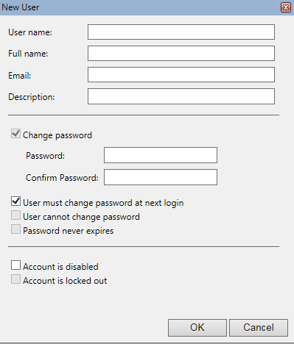
Create New User Profile
Enter the following:
Username (case sensitive / no spaces)
Full name
Email
Description
Password … use the word: “password” (no caps)
Uncheck “User must change password at next login”
Click “OK”

Slide 14
Example of User Profile
Enter Agency UCR email address
Enter “agency” for description

Slide 15
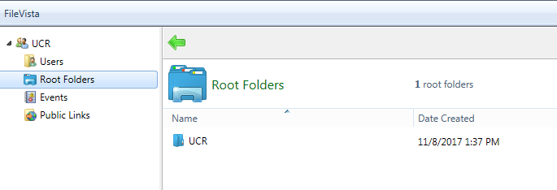
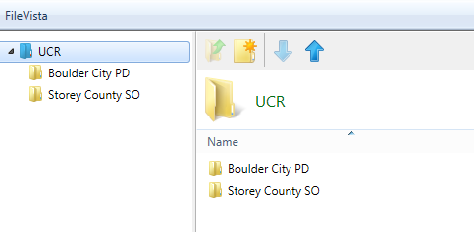
Create a New Folder
Click “Root Folders” on the left-side of screen
Click the Green Arrow on the top left of the Left-side screen
Click the “New Folder” icon
Name the Folder, click “OK”
2. Click the Green Arrow

Slide 16
Go back to Administration Screen
1. Click “username” in top right-hand corner
2. Click “Administration”

Slide 17
Get to Folder Permissions
1. Click “Root Folders”
2. Double Click “UCR”

Slide 18
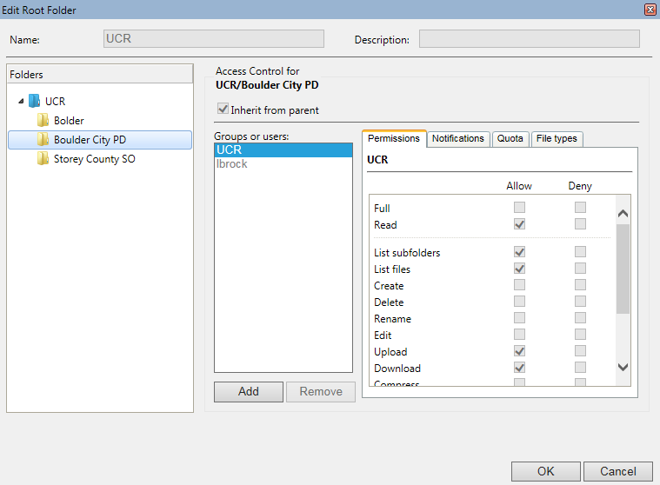
Edit Folder Permissions
Select the folder
Click “UCR”
Select Permissions:
Read
List Subfolders
List Files
Upload
Download
Copy
4. Click “UCR”
4. Select Permissions

Slide 19
Switch from Administration View to Folder View
1. Click the Green Arrow
2. Double-Click the folder

Slide 20
How to Download a File
Select the File
Click the blue “Download” Arrow
The file should be in the “Downloads” File on your computer

Slide 21
Contact Information
Laurel Brock, DPS Statistician II
Email: lbrock@dps.state.nv.us
Phone: 775.684.6244
Tammy Vieira, UCR Program Specialist
Email: tvieira@dps.state.nv.us
Phone: 775.684.6202

