Slide 1
National Incident Based Reporting System (NIBRS)
Raymond Mansi & Christina Wilson
Nevada Department of Public Safety State Police
Records, Communications, and compliance division
NCJIS Program Specialists
Notes:
Introduce myself
Have class introduce themselves
Talk about expectations

Slide 2
Class goals
Intro
Gain an understanding of State and Federal practices of NIBRS.
Be able to effectively utilize resources.
Clarify Quality Assurance Review(QAR).
Understand state Domestic Violence and Crimes Against the Elderly/Vulnerable person Requirements

Slide 3
objectives
Intro
Participants will understand the State vs. Federal Definitions while utilizing the resources for this program as needed.
Participants should be able to locate and utilize the NIBRS User Manual with little assistance.
Agencies should be able to identify your error codes by using the NIBRS Technical Specifications guide with little assistance.

Slide 4
Introduction to NIBRS
Intro
Nationwide, cooperative statistical effort of over 18,000 law enforcement agencies (LEAs) reporting crime.
Incident-based reporting overtook summary data (SRS) starting in 1989.
State of Nevada mandated the move to NIBRS on January 1, 2021
NRS 179A.075
60 LEAs currently submitting NIBRS data to the State Repository
Benefits:
Detailed crime analyses can be made within and across LE jurisdictions.
Arrests and clearances can be linked to specific incidents and offenses.
Greater specificity in Reporting offenses, with a complete overlook of incidents not just hierarchy.
Agency Benefits: Open specific grants/funding opportunities with compliance.

Slide 5
The Parties within NIBRS
Admin
Nevada Offense Code (NOC) Unit
Responsible for creating, editing, and removing Nevada Offense Codes once passed by legislation.
State as well as local ordinances.
Nevada UCR Program (NIBRS Team)
Responsible for monitoring, assisting, and analyzing crime statistics from each Nevada LEA.
FBI CJIS Division (UCR Program)
Responsible for collecting, analyzing, and publishing national crime statistics from more than 18,000 LEAs across the United States.
Law Enforcement Agencies (LEAs)
Conduct their day-to-day activities and use their RMSs to fit their needs including information required for administration and operation. An agency’s RMS will then send the necessary data for NIBRS to the Nevada UCR Program.

Slide 6
Reporting Agency Coordinator (RAC)& Assistant (ARAC) Responsibilities
Admin
Primary Liaison
First contact person for the Department of Public Safety.
Must notify State UCR Program within 10 days in writing of any changes to RAC/ ARAC
Quality Assurance Review Guidelines
If an ARAC cannot attend the training, the RAC is authorized to provide training to their ARAC.
The RAC/ARAC ensures agency personnel complete State of Nevada in-person/virtual training every two years to maintain compliance and receive up-to-date information.
All sworn and non-sworn personnel who either enter data into your agency’s Record Management System (RMS) or who validate the reports must obtain required training (NCJIS Administrative Policy Section 11.3) by either the State of Nevada UCR staff or by their agency RAC within the first six months of appointment and every two years thereafter.
Maintains their Completion Certificates on file for Operating Personnel for the quality review cycle for QAR purposes.
Notes:
RAC /ARAC are our

Slide 7
RAC/ARAC Additional Responsibilities
Admin
Ensure data submissions meet State and FBI standards and the timeline for monthly, quarterly, and annual deadlines.
Address errors/warnings in a timely manner
Monitor uploads weekly to ensure data errors and warnings are kept to a minimum for quality assurance purposes.
Strive for ZERO percent Error Rate, Each category has a caveat to maintain under 4% for Group A and Group B
Notes:
1st bullet advise they have handout in front of them.

Slide 8
State Monitoring Federal Quality Assurance Review Process
Admin
Every LEA in the State of Nevada that submits NIBRS data to the Central Repository will go through the State Monitoring Federal Quality Assurance Review Process (QAR)
RACs will be notified of your scheduled QAR via email
Forms will be sent out to agency RAC to be completed before the QAR takes place
Details to follow

Slide 9
NIBRS QUALITY ASSURANCE REVIEW
Admin
The UCR Program would like to explore how NIBRS procedures are versed by LEAs in order to make NIBRS implementation more effective for all parties involved.
The purpose of this quality assurance review is to gain a better understanding of your agency’s process as it pertains to NIBRS operations.
Important to understand the data submitted is YOUR AGENCY’s data, we won’t alter it in any way
Crucial to be accurate and timely in your submissions

Slide 10
Quality Assurance Review
Admin
The UCR Program will complete an Agency Review for Quality Assurance purposes
Similar to the FBI’s Quality Assurance process
We want to ensure agencies are reporting correctly to get the most accurate and complete data
This process will also help identify deficiencies in your LEAs practice so we may tailor our training program to meet the needs of your specific agency.

Slide 11
Supplemental Documentation for quality assurance
Admin
UCR program will ask for specific incidents and supplemental information associated with those incidents (i.e., police reports).
Can be scanned and emailed or provided on-site.
Once incidents are reviewed, feedback will be sent on errors and assistance will be provided to agencies.
QAR process is used to ASSIST and PROMOTE better crime data and address issues moving forward to make NIBRS process efficient and easier.

Slide 12
Rms Certification Requirement
Admin
Agencies using RMS Providers to complete their UCR submissions, must complete and maintain training through their provider.
Once the agency’s RMS is set up for NIBRS purposes, LEA will upload 3 months of data into the test website.
Ensure the RMS and State program “speak” correctly to ensure errors are at a minimum.
Upload .xml file to “Crime Insight” production website if LEA chooses to use RMS.
Requirements for RMS to meet Certification:
System Appropriateness
Update Capability and Responsiveness
Error Rate
Statistical Reasonableness
Timeliness

Slide 13
Rms Certification Requirement (cont.)
Admin
Certification is required one time in the State of Nevada
Change of RMS requires recertification
Changing from Spillman to Tiburon
LEA agencies may choose to enter or update cases directly into the Crime Insight production website.

Slide 14
Training certification process
Admin
All sworn and nonsworn personnel who engages with NIBRS Process are required to be trained, RAC/ARAC will ensure this for the agency.
These certificates or copies must be kept on file for a QAR cycle and updated as individuals become trained
Agency RAC/ARACs are allowed to create their own NIBRS training to train their own personnel, but it must be approved by the State UCR program prior to implementation.
Must have all of the training criteria listed below:
Agency Internal Written Procedures
NIBRS Structure
Submission Dates
Common Quality Assurance Items
Defining Group A and Group B Offenses
Notes:
Agency RAC/ARAC’s are allowed to create their own NIBRS training to train their own personnel, but it must be approved by the State UCR program prior to implementation, including the following criteria:
Domestic Violence reporting.
Crimes Against the Elderly & Vulnerable Persons reporting
NOC usage
Examples on how to report NIBRS to the FBI
List the criteria that will be required in training. This will give them some structure to follow when creating their trainings, as well as give us structure to follow when approving trainings.
These were the points that I think that would need to be covered in an agency’s NIBRS training.

Slide 15
Training Certification process (cont.)
Admin
State Specific: Domestic Violence and Crimes against Older Persons
Zero Report
Resources
***NOTE: To receive credit for NIBRS training provided by a private vendor, all training material must be submitted for approval to the State of Nevada UCR Program and must meet all the training criteria listed above.
Training must be obtained within 60 days of appointment/ employment and recertified every 2 years to maintain compliance.

Slide 16
Agency Internal Written Procedures (IWP’s)
Admin
With agencies having a high turnover, it is important that IWP’s are formulated to create a smooth transition in management and NIBRS data uploads/submissions
RAC/ARACs do not need to notify the State of Nevada UCR Program of any changes to your agency’s IWP’s but will be kept on file and will be presented to the NIBRS team upon request
Items to include on an IWP:
Agency Procedures and Duties
Submission instructions specific to agencies RMS provider
Training of authorized personnel
Maintain current authorized Personnel List
NIBRS Certifications
Addressing Errors and Warnings
Deadlines

Slide 17
Agency Operating Personnel List
Admin
RAC/ARAC shall maintain records of agency personnel who are responsible for uploading/validating any type of NIBRS data.
This list must be updated and maintained of individuals responsible for entering, editing, uploading NIBRS data/files has completed their required training.
This list does not have to be sent to the State of Nevada UCR Program when additional personnel are added.
ONLY a change in the RAC/ARAC is required to be sent to the UCR Program for contact purposes.
The Operating Personnel List is required to be kept on file.

Slide 18
FBI Quarterly Reporting Schedule
Data
Jan-March data = May 2022; Release June 2022
April-June data = August 2022; Release September 2022
July-Sept data = November 2022; Release December 2022
Oct-Dec data= February 2023; Release March 2023

Slide 19
Zero Report
Data
If your agency has no incidents/arrests/calls for service for a given month, you will still submit a “Zero Report”
This allows the State UCR Program and the FBI to differentiate between agencies who are late/forgot to submit data and agencies who had no incidents/arrests/calls for service

Slide 20
NIBRS Publications
Data
Past publications:
https://rccd.nv.gov/About/UCR/Crime-In-Nevada/
FBI
https://crime-data-explorer.fr.cloud.gov/
“Crime in the United States”
Updated Quarterly and Yearly

Slide 21
NIBRS Publications
Data
TOPS Website
https://nevadacrimestats.nv.gov/tops/
Updated overnight and consists of all the NIBRS data in State Repository
Ability to view crime statistics by Year, Jurisdiction, and Theme (Group A offenses or Group B offenses
Compares from previous year
Presented in graphs and descriptive statistics

Slide 22
TOPS Data
Data
Data comes from what is uploaded into https://nevadacrimestats.nv.gov/
If errors and warnings are not corrected agency’s totals will not be as accurate as possible.
Once an agency uploads and/or updates a file the totals will reflect the next day on the TOPS website.
Public has access to this data.
Media, Residents, Students, etc.

Slide 23
Data
Collects data on:
Calls for Service
Complaints
Investigations
Does not include findings from:
Court
Coroner
Jury
Prosecutorial Discretion
Data Collection

Slide 24
NIBRS Group A Offenses
Data
Crimes Against Persons
One offense is counted for each victim.
Crimes Against Property
One offense is counted for each distinct operation.
Exception:
For Motor Vehicle Theft, one offense is counted per stolen vehicle.
Crimes Against Society
Count one per each crime against society.
While these may seem self explanatory, issues arise in certain reported incidents.

Slide 25
CATEGORIES Within NIBRS
Data
NIBRS allows agencies across the United States to produce crime statistics in one common language.
Data Reliability (consistency) and Validity (accuracy)
Group A Offenses
28 offense categories
Made up of 71 specific crimes. Report administrative, offense, property, victim, offender, and arrestee information
Group B Offenses
10 offense categories
Only report arrest data

Slide 26
Group A Offense one off's
Data
When a Group A offense is prefixed by:
Accessory Before/After the Fact
Aiding/Abetting
Conspiracy to Commit
Facilitation of
Solicitation to Commit
Threat to Commit, etc.
Enticement
Will be Reported as 90Z
Example: An LEA arrested three members of a motorcycle gang for conspiracy to commit Murder. The LEA should submit three Group B Arrest Reports with the UCR Arrest Offense Code entered as 90Z = All Other Offenses.

Slide 27
Data
(90B) Curfew/ Loitering/ Vagrancy Violations
(90C) Disorderly Conduct
(90D) DUI
(90F) Family Offenses, Nonviolent
(90G) Liquor Law Violations
(90I) Runaway
(90J) Trespass of Real Property
(90Z) All Other Offenses
(90A) Bad Checks
(90E) Drunkenness
(90H) Peeping Tom
* If the omitted crimes are input in their original code, they will automatically be converted to 90Z
Group B Offenses:
Only reported to NIBRS if an arrest was made.

Slide 28
What is a NIBRS Incident?
Data
For NIBRS, the FBI UCR Program defines an incident as one or more offenses committed by the same offender, or group of offenders acting in concert, at the same time and place.

Slide 29
Data

Slide 30
NIBRS User Manual
Data
General Explanations Offenses
Program overview
Crime Definitions
Crime Coding

Slide 31
NIBRS Technical Specifications
Data
Ensure the most up to date version is being utilized
A great resource for RMS Vendors
Breaks out the Data Elements for NIBRS
Full Description of Error codes
Full description of Warning codes

Slide 32
Jurisdictional AND Multi-player gaming
Data
Jurisdiction is important to depict the nature and amount of crime in a particular community
To ensure there is no duplicate data (arrest or offense) when LEAs have overlapping jurisdictions:
When two or more LEAs are involved in the investigation of the same offense, the agency with investigative jurisdiction should report the offense or “Taking the lead”.
The recovery of property should be reported only by the LEA that first reported it missing and/or stolen, regardless of which agency recovered it.
If an agency defers the investigation of an incident to another agency. The incident will only be entered by the referred agency

Slide 33
Acting in Concert/Time and Place
Data
Acting in Concert
Same Time and Place
Acting in Concert requires All the offenders to actually commit or assist in the commission of all of the crimes in an incident. The offenders must be aware of, and consent to, the commission of all the offenses; or even if nonconsenting, their actions assist in the commission of all the offenses.
This is important because NIBRS considers all of the offenders in an incident to have committed all of the offenses in an incident.
The arrest of any offender will clear all of the offenses in the incident.
If one or more of the offenders did not act in concert, then the LEA should report more than one incident.
This concept is if the same person or group of persons committed more than one crime and the time and space intervals separating them were insignificant, all the crimes make up a single incident.
Normally, the offenses must have occurred during an unbroken time period and at the same or adjoining locations.
However, incidents can also be comprised of offenses which, by their nature, involve continuing criminal activity by the same offenders at different times and places if, LEA deems the activity to constitute a single criminal transaction.
Embezzlement

Slide 34
Example 1: How Many Incidents?
Data
Situation
Answer
In this example, there were two incidents: one involving Robbery and the other involving Rape, because the offenders were not acting in concert in both offenses. The LEA should report two incidents, each with one offense.
Two offenders robbed a bar, forcing the bartender to surrender money from the cash register at gunpoint. The robbers also took money and jewelry from three customers. One of the robbers, in searching for more customers to rob, found a female customer in the rest room and raped her there without the knowledge of the other offender. When the rapist returned, both robbers left.

Slide 35
What’s the nibr’s offense
Data
A white male walked into a liquor store, displayed a handgun, and announced a hold-up. A passing police officer observed the robbery and confronted the robber as the suspect exited the store. The police officer and suspect exchanged gunfire. The police officer was shot and suffered major injuries. The suspect was killed.
What are the reportable NIBRS Offense(s)?
120 Robbery, 13A Aggravated Assault, 09C Justifiable Homicide

Slide 36
Example 2: How Many Incidents?
Data
Answer
Situation
The LEA should have reported this information via NIBRS as two separate incidents because the husband could not have been acting in concert with the wife in his own homicide. The LEA would submit one incident involving the aggravated assault perpetrated by the husband and a second incident involving the homicide.
A domestic argument escalated from a shouting match between a husband and wife to an aggravated assault during which the husband began beating his wife. The wife, in her own defense, shot and killed her husband.

Slide 37
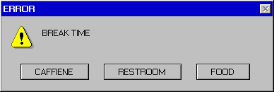

Slide 39
Video Questions
Data
How many incidents?
1
How many offenses?
3 (Robbery, Motor Vehicle Theft, Aggravated Assault)
How many offenders?
3
How many victims?
1

Slide 40
Incident Layout
Data

Slide 50
Key Issues In NIBRS REPORTING
Reporting
NOC’s
Updating Incidents
Errors vs. Warnings
Cargo Theft
Hate Crimes
QAR for submissions

Slide 51
NEVADA Offense Codes [NOC]
Reporting
One of the Nevada UCR Program’s biggest issues
Bi-Monthly NOC User Spreadsheet sent to all the users via email – (request to be added to the list) to the NOC Unit: nocrequest@dps.state.nv.us
Problem arises with an Error Code in Crime Insight website
“Invalid NOC”, “NOC was invalid at the date of the incident”, “NOC does not correspond with NIBRS code”
Occurs when vendor pulls excel spreadsheet from NOC Unit and cannot read updated NOCs
Could simply be a user error as well
Can also occur based on individual agency’s RMS and coding issues
Contact Nevada UCR Program about an issue, we will investigate and find a solution and contact RAC/ARAC.
The NOC search tool can be found at:
https://www.nvcrimemapping.com/noc-search

Slide 52
Updating Incidents
Reporting
A common issue is seen when implementing NIBRS. LEAs not updating/changing information to match accurately to the reports/supporting documentation after originally submitted to the Central Repository.
For instance, An incident where there is no known offender, and no arrest had been made and 3 months later, law enforcement makes an arrest.
Agency IWP should be followed, responsible person in the agency to update go back into the incident and add the offender’s information as well as the arrest information.
LEAs need to remember to update so the UTD accurate information is being presented for your town/county/state statistics.

Slide 53
Warnings vs. Errors
Reporting
Warnings
Warnings are data values that are technically not wrong but are unusual or not defined enough.
Can a 5-year-old commit a crime?
They technically could but the odds that the offender was 5 is low.
Warnings do not prevent an incident from going to the FBI nor do they prevent the incident from being accepted by Crime Insight.
Errors
Errors are data values that are not correct based off a current data value options.
Errors will not process at the FBI level, and as a result will lead to the incidents not being included in the FBI stats.
FBI Technical Specifications has a list of error codes for FBI related errors while the State Technical Specifications has a list of error codes for state specific errors.

Slide 54
Cargo Theft
Reporting
Cargo Theft is the criminal taking of any cargo including, but not limited to, goods, chattels, money, or baggage that constitutes, in whole or in part, a commercial shipment of freight moving in commerce, from any pipeline system, railroad car, motor truck, or other vehicle, or from any tank or storage facility, station house, platform, or depot, or from any vessel or wharf, or from any aircraft, air terminal, airport, aircraft terminal or air freight station, warehouse, freight distribution facility, or freight consolidation facility.

Slide 55
Cargo Theft Example 1
Reporting
Example 1: Walmart delivery truck leaves Bentonville, Arkansas heading to a local Walmart in Carson City, Nevada. As the truck arrives in the area to make the delivery, he stops at a local restaurant to get something to eat. When he returns to his truck it is missing along with the merchandise.
This should be flagged as Cargo Theft.
This would be Cargo Theft if only the packages were being delivered to a business; if discovered it was being delivered to a private individual(s) an update to mark NO on cargo theft.

Slide 56
Cargo Theft Example 2
Reporting
Example 2: LOWES delivery truck leaves a distribution center in Henderson, Nevada with a load of appliances for a local LOWES store in Las Vegas, Nevada. Before arriving at the local store in Las Vegas he stops at a local rest stop to use the facilities. Upon his return, he notices that someone has entered into the back of the truck and unloaded several of the appliances.
This should be flagged as Cargo Theft.

Slide 57
Hate Crimes
Reporting
Data Element 8A (Bias Motivation) is used to indicate whether an offense was motivated by the offender’s bias and, if so, what type of bias. LEAs can enter up to five bias motivations per offense type.
Because of the difficulty of ascertaining the offender’s subjective motivation, LEAs should report a biased motivation only if an investigation reveals sufficient objective facts to lead a reasonable and prudent person to conclude the offender’s actions were motivated, in whole or in part, by bias against race/ethnicity/ancestry, religion, disability, gender, gender identity, or sexual orientation.

Slide 58
Hate Crimes Continued
Reporting
Unless the bias for a hate crime falls into one of the FBI UCR Program’s bias categories, an agency should report zero hate crime data. LEAs should report zero hate crime data as data value 88=None. In NIBRS, incidents not involving any facts indicating bias motivation on the part of the offender are to be reported as 88=None, whereas incidents involving ambiguous facts (some facts are present but are not conclusive) should be reported as data value 99 = Unknown. When an offense is initially classified as bias motivation 99 = Unknown and the subsequent investigation reveals the crime was motivated by bias or no bias was found, the agency must update its original submission.

Slide 60
Break

Slide 61
Incident Activity
Reporting
With the next few screenshots, take notes and let us know what you think the ERROR or the WARNING would be???
Each example will have 6 slides.
Answers to the potential QAR findings will be reviewed at the end

Slide 62
Scenario Example 1

Slide 68
Scenario 1: answer
Reporting
Property of Credit Card reported Stolen with ATM Fraud.
ATM Fraud does not apply to the theft of a credit/debit card but rather its fraudulent use.
PG 26 of the NIBRS User Manual

Slide 69
Scenario Example 2

Slide 75
scenario 2: answer
Reporting
Agency selected that this incident was a Cargo Theft.
The odds that $500 worth of tools were stolen from someone’s residence indicates that the likelihood that a Cargo Theft occurred is extremely low.

Slide 76
Example What’s the offense?
Situation
A motor vehicle was broken into and the radio was stolen out of the vehicle.
What are the reportable NIBRS Offense(s)?
23G Theft of Motor Vehicle Parts and Accessories
290 Destruction/Damage/Vandalism if deemed substantial damage

Slide 77
Scenario 3
Reporting
A vehicle was broken into. The car’s in-dash navigation unit was stolen. In addition, a laptop was taken from the backseat.
What are the reportable NIBRS Offense(s)?
What are potential issues with how this incident was submitted?
Keep note of the previous slide.

Slide 78
Scenario Review

Slide 80
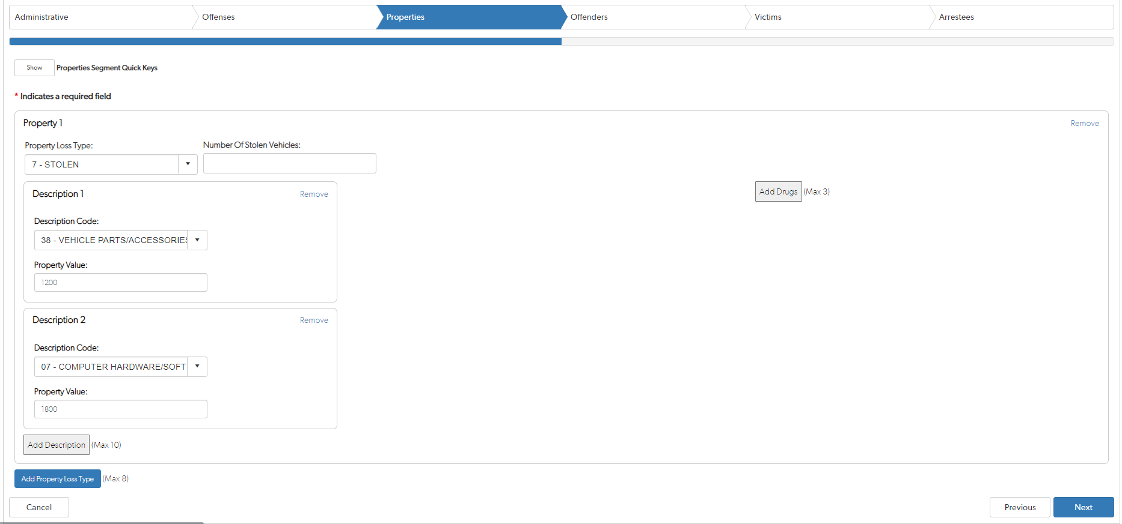

Slide 84
SCENARIO 3 Answer
Reporting
23G Theft of Motor Vehicle Parts and Accessories, 23F Theft from a Motor Vehicle, 290 Destruction/Damage/ Vandalism.
Once an arrest is made, or Property Recovered, update and indicate the information.

Slide 85
Accessories vs not.
Reporting
If the agency is trying to report that the car radio was stolen, then 23G Theft of Motor Vehicle Parts and Accessories & 38 = Vehicle Parts/Accessories should be the selection.
If the offender did indeed take a TV or DVD player from the back seat then the 23F and 26 = Radios/TVs/VCRs/DVD Players selections are correct.

Slide 86
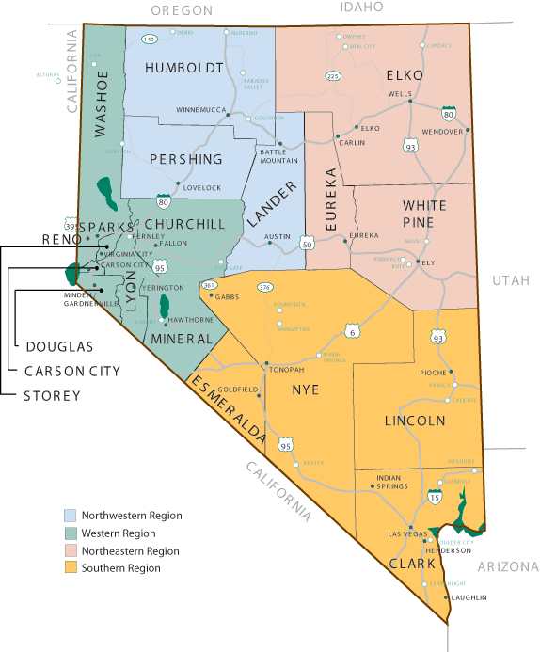
State of Nevada Specifics
This Photo by Unknown Author is licensed under CC BY-SA

Slide 87
Domestic Violence Requirements
State
NRS 33.018
Acts which constitute domestic violence
NRS 171.1227
Advises what information needs to be collected and forwarded to the Central Repository for data collection
Notes:
NRS 33.018 Acts which constitute domestic violence.
1. Domestic violence occurs when a person commits one of the following acts against or upon the person’s spouse or former spouse, any other person to whom the person is related by blood or marriage, any other person with whom the person has had or is having a dating relationship, any other person with whom the person has a child in common, the minor child of any of those persons, the person’s minor child or any other person who has been appointed the custodian or legal guardian for the person’s minor child:
(a) A battery.
(b) An assault.
(c) Compelling the other person by force or threat of force to perform an act from which the other person has the right to refrain or to refrain from an act which the other person has the right to perform.
(d) A sexual assault.
(e) A knowing, purposeful or reckless course of conduct intended to harass the other person. Such conduct may include, but is not limited to:
(1) Stalking.
(2) Arson.
(3) Trespassing.
(4) Larceny.
(5) Destruction of private property.
(6) Carrying a concealed weapon without a permit.
(7) Injuring or killing an animal.
(f) A false imprisonment.
(g) Unlawful entry of the other person’s residence, or forcible entry against the other person’s will if there is a reasonably foreseeable risk of harm to the other person from the entry.
2. As used in this section, “dating relationship” means frequent, intimate associations primarily characterized by the expectation of affectional or sexual involvement. The term does not include a casual relationship or an ordinary association between persons in a business or social context.
(Added to NRS by 1985, 2283; A 1995, 902; 1997, 1808; 2007, 82, 1275; 2017, 3179)
NRS 171.1227 Peace officer to submit written report concerning suspected acts of domestic violence; information from reports to be aggregated and forwarded to Central Repository; content of report.
1. If a peace officer investigates an act that constitutes domestic violence pursuant to NRS 33.018, the peace officer shall prepare and submit a written report of the investigation to the peace officer’s supervisor or to another person designated by the peace officer’s supervisor, regardless of whether the peace officer makes an arrest.
2. If the peace officer investigates a mutual battery that constitutes domestic violence pursuant to NRS 33.018 and finds that one of the persons involved was the primary physical aggressor, the peace officer shall include in the report:
(a) The name of the person who was the primary physical aggressor; and
(b) A description of the evidence which supports the peace officer’s finding.
3. If the peace officer does not make an arrest, the peace officer shall include in the report the reason the peace officer did not do so.
4. The information contained in a report made pursuant to subsections 1 and 2 must be:
(a) Aggregated each month; and
(b) Forwarded by each jurisdiction to the Central Repository for Nevada Records of Criminal History not later than the 15th day of the following month.
5. The Director of the Department of Public Safety shall prescribe the form on which the information described in subsection 4 must be reported to the Central Repository. In addition to the information required pursuant to subsections 1 and 2, the form must also require the inclusion of the following information from each report:
(a) The gender, age and race of the persons involved;
(b) The relationship of the persons involved;
(c) The date and time of day of the offense;
(d) The number of children present, if any, at the time of the offense;
(e) Whether or not an order for protection against domestic violence was in effect at the time of the offense;
(f) Whether or not any weapons were used during the commission of the offense;
(g) Whether or not any person required medical attention;
(h) Whether or not any person was given a domestic violence card that contains information about appropriate counseling or other supportive services available in the community in which that person resides;
(i) Whether or not the primary physical aggressor, if identified, was arrested and, if not, any mitigating circumstances explaining why an arrest was not made; and
(j) Whether or not any other person was arrested.
(Added to NRS by 1997, 1533; A 2007, 2482)

Slide 88
What Constitutes Domestic Violence?
State
The following Offenses constitute a domestic violence incident:
Arson
Battery
Assault
False Imprisonment
Forcible Entry
Stalking
Trespassing
Sexual Assault
Destruction of Property
Carrying a CCW w/o Permit
Injuring or Killing an Animal
Unlawful Entry
Notes:
All the above incidents indicate Domestic Violence. They are broken into two separate categories to show what you would code them as for NIBRS purposes. Either a Group A – Crimes against Person or a Group B – Crimes against Property. If your agency is reporting a crimes against property we will go into further depth on how to code it for NIBRS.
Battery is stated in the law but it is not accepted by the FBI. Any battery would be coded as a 13A-13C depending on the circumstances.

Slide 89
DV1
State
The Nevada Domestic Violence definition can include certain NIBRS offenses that are within the Crime Against Society category.
Since person information is not collected for Crimes Against Society, the DV1 must be added to gather the person information required by NRS 171.1227.
The offense code "DV1" is not sent to the FBI but remains in the data repository.

Slide 90
What Specific Information Is Collected?
State
Per NRS 171.1227, we must collect the following for each Domestic Violence incident.
Gender, Age, and Race of the persons involved
The relationship of the persons involved
Day and time the incident happened
Number of children present during the incident
Whether or not there was an order of protection when the incident occurred
Whether or not there were any weapons used during the incident
Whether or not medical attention was required
Whether or not a Domestic Violence (DV) card was given
Were there any other persons arrested during the incident
For example: If you are called to a DV incident and a neighbor has been involved in the incident and gets arrested this is where you would collect how many other persons besides the offender was arrested.
Notes:
NRS 171.1227 specific what information the repository needs to collect for each incident. If your agency is unable to report a piece of the puzzle that is ok. You can put unknown

Slide 91
What specific information is collected? cont.
State
Was there a primary aggressor?
Was the primary aggressor arrested?
If they were not arrested, why?
Report reason why aggressor was not arrested.
6 reasons:
Aggressor undetermined
Gone upon arrival
No evidence of injury
Not reported within 24 hours
Other
Unknown

Slide 92
What Relationships Are Collected?
State
Per NRS 33.018 the following relationships constitute domestic violence
Spouse
Former Spouse
Any other person related by blood or marriage
For example, mother-in-law, father-in-law
Any person who has/had or is having a dating relationship
Ex-boyfriend/girlfriend
If there is a child in common
Minor children of the persons involved
Any appointed custody or guardianship of the children
Notes:
NRS 33.018 defines specifically what relations constitute domestic violence

Slide 93
Crimes Against the Elderly & Vulnerable Persons

Slide 94
State
Types of abuse?
Why are we collecting it?
What information is collected by the Central Repository and reported?
OVERVIEW
Notes:
NRS 179A.450 Creation; contents; submission of report to Legislature; confidentiality of data.
1. The Repository for Information Concerning Crimes Against Older Persons or Vulnerable Persons is hereby created within the Central Repository.
2. The Repository for Information Concerning Crimes Against Older Persons or Vulnerable Persons must contain a complete and systematic record of all reports of the abuse, neglect, exploitation, isolation or abandonment of older persons or vulnerable persons in this State. The record must be prepared in a manner approved by the Director of the Department and must include, without limitation, the following information:
(a) All incidents that are reported to state and local law enforcement agencies and the Aging and Disability Services Division of the Department of Health and Human Services.
(b) All cases that were investigated and the type of such cases.
3. On or before July 1 of each year, the Director of the Department shall prepare and submit a report to the Director of the Legislative Counsel Bureau for transmittal to the Legislature that sets forth statistical data on the abuse, neglect, exploitation, isolation or abandonment of older persons or vulnerable persons.
4. The data and findings generated pursuant to this section must not contain information that may reveal the identity of an individual victim or a person accused of the abuse, neglect, exploitation, isolation or abandonment of older persons or vulnerable persons.
5. As used in this section:
(a) “Abandonment” has the meaning ascribed to it in NRS 200.5092.
(b) “Abuse” has the meaning ascribed to it in NRS 200.5092.
(c) “Exploitation” has the meaning ascribed to it in NRS 200.5092.
(d) “Isolation” has the meaning ascribed to it in NRS 200.5092.
(e) “Neglect” has the meaning ascribed to it in NRS 200.5092.
(f) “Older person” means a person who is 60 years of age or older.
(g) “Vulnerable person” has the meaning ascribed to it in NRS 200.5092.
(Added to NRS by 2007, 746; A 2009, 2447; 2011, 82; 2015, 826; 2017, 2685; 2019, 3473)

Slide 95
State
TYPES OF ABUSE
Abandonment
Abuse:
Physical
Psychological
Sexual
Neglect
Exploitation
Isolation
Self Neglect

Slide 96
How it’s defined
State
As defined per NRS 200.5092, an older person is a person 60 years of age or older.
As defined per NRS 200.5092, a vulnerable person is a person 18 years of age or older who:
Suffers from a condition of physical or mental incapacitation because of a developmental disability, organic brain damage or mental illness; or
Has one or more physical or mental limitations that restrict the ability of the person to perform the normal activities of daily living.

Slide 97
State
ABANDONMENT
Abandonment as defined:
Desertion of an older person or a vulnerable person in an unsafe manner by a caretaker or other person with a legal duty of care; or
Withdrawal of necessary assistance owed to an older person or a vulnerable person by a caretaker or other person with an obligation to provide services to the older person or vulnerable person.
Notes:
Family Offenses, Nonviolent - 90F Crime Against Society
Definition - Unlawful, nonviolent acts by a family member (or legal guardian) which threaten the physical, mental, or economic well-being or morals of another family member and which are not classified as other offenses, such as Assault, Incest, Statutory Rape, etc.

Slide 98
State
ABUSE
Abuse as defined:
Infliction of pain or injury on an older person or a vulnerable person;
(b) Deprivation of food, shelter, clothing or services which are necessary to maintain the physical or mental health of an older person or a vulnerable person;
(c) Infliction of psychological or emotional anguish, pain or distress on an older person or a vulnerable person through any act, including, without limitation:
(1) Threatening, controlling or socially isolating the older person or vulnerable person;
(2) Disregarding the needs of the older person or vulnerable person; or
(3) Harming, damaging or destroying any property of the older person or vulnerable person, including, without limitation, pets;

Slide 99
Abuse Cont.
State
(d) Nonconsensual sexual contact with an older person or a vulnerable person, including, without limitation:
(1) An act that the older person or vulnerable person is unable to understand or to which the older person or vulnerable person is unable to communicate his or her objection; or
(2) Intentional touching, either directly or through the clothing, of the genitalia, anus, groin, breast, inner thigh or buttocks of the older person or vulnerable person; or
(e) Permitting any of the acts described in paragraphs (a) to (d), inclusive, to be committed against an older person or a vulnerable person.

Slide 100
State
NEGLECT
Neglect as defined :
The failure of a person or a manager of a facility who has assumed legal responsibility or a contractual obligation for caring for an older person or a vulnerable person or who has voluntarily assumed responsibility for his or her care to provide food, shelter, clothing or services which are necessary to maintain the physical or mental health of the older person or vulnerable person.

Slide 101
EXPLOITATION
State
Exploitation as defined :
Any act taken by a person who has the trust and confidence of an older person or a vulnerable person or any use of the power of attorney or guardianship of an older person or a vulnerable person to:
(a) Obtain control, through deception, intimidation, or undue influence, over the older person’s or vulnerable person’s money, assets, or property with the intention of permanently depriving the older person or vulnerable person of the ownership, use, benefit, or possession of his or her money, assets or property; or
(b) Convert money, assets, or property of the older person or vulnerable person with the intention of permanently depriving the older person or vulnerable person of the ownership, use, benefit, or possession of his or her money, assets, or property
Notes:
Family Offenses, Nonviolent - 90F Crime Against Society
Definition - Unlawful, nonviolent acts by a family member (or legal guardian) which threaten the physical, mental, or economic well-being or morals of another family member and which are not classified as other offenses, such as Assault, Incest, Statutory Rape, etc.

Slide 102
State
ISOLATION
Isolation as defined:
preventing an older person or a vulnerable person from having contact with another person by:
(a) Intentionally preventing the older person or vulnerable person from receiving visitors, mail or telephone calls, including, without limitation, communicating to a person who comes to visit the older person or vulnerable person or a person who telephones the older person or vulnerable person that the older person or vulnerable person is not present or does not want to meet with or talk to the visitor or caller knowing that the statement is false, contrary to the express wishes of the older person or vulnerable person and intended to prevent the older person or vulnerable person from having contact with the visitor.

Slide 103
ISOLATION CONTINUED
State
(b) Physically restraining the older person or vulnerable person to prevent the older person or vulnerable person from meeting with a person who comes to visit the older person or vulnerable person; or
(c) Permitting any of the acts described in paragraphs (a) and (b) to be committed against an older person or a vulnerable person.

Slide 104
State
DATA COLLECTED BY THE CENTRAL REPOSITORY
Abuse
Neglect
Exploitation
Isolation
Abandonment
Note: we collect the number of offenses reported for each on a monthly basis. Currently our database collects Elder Abuse data as collecting data on vulnerable persons is in the works.

Slide 105
QUESTIONS?

Slide 106
Assault within NIBRS
State

Slide 107
How to Report Assaults in NIBRS
State
First determine do the details make the assault aggravated or simple assault.
Make sure to select an appropriate NOC to use for reporting the incident.
Enter the incident into the RMS.
Upload file from the RMS to the state production website.

Slide 108
Aggravated vs. Simple Assault
State
13A Aggravated Assault
An unlawful attack by one person upon another wherein the offender uses a dangerous weapon or displays it in a threatening manner, or the victim suffers obvious severe or aggravated bodily injury, or where there was a risk for serious injury/intent to seriously injury.
13B Simple Assault
An unlawful physical attack by one person upon another where neither the offender displays a dangerous weapon, nor the victim suffers obvious severe or aggravated bodily injury involving apparent broken bones, loss of teeth, possible internal injury, severe laceration, or loss of consciousness.

Slide 109
Important Things to Consider
State
Getting as many details as possible about what occurred during the incident and documenting those are important.
The QAR process will take a look at all the supporting documentation that is associated with the incident that is being reviewed.
If aggravated assault was selected the agency will need to report a weapon and/or a severe or aggravated bodily injury.
If the only thing in the report is that the offender smacked the victim, then there is nothing that shows that an aggravated assault should have been selected.

Slide 110
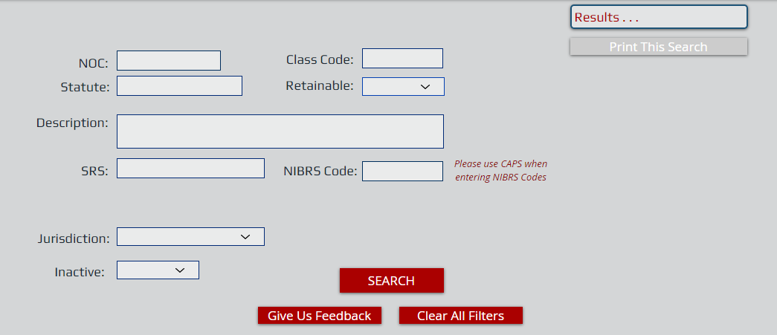
Selecting the Correct NOC
State
The officer determined that the incident should be an aggravated assault.
Use the following fields in the NOC search tool to help find a NOC for the aggravated assault incident:
Class Code
Statute
NIBRS Code
Jurisdiction
The NOC search tool can be found at:
https://www.nvcrimemapping.com/noc-search

Slide 111
NOC Selection
For this incident NOC 50214 is a NOC that will pass validation.
NOC 50214 is active since there is no “Y” under repealed.
13A (Aggravated Assault) is a valid NIBRS code for this NOC.
*Note the Jurisdiction field should be “NV” or the code for the jurisdiction that the agency is located in.

Slide 112
Entering the Incident
State
This will vary by agency and by RMS.
Each agency needs to enter all incidents into the RMS.
At the end of the month the agency will upload a file to the state production website.
https://nevadacrimestats.nv.gov/
The file that gets uploaded to https://nevadacrimestats.nv.gov/ is the file that will be submitted to the FBI.
Agencies are responsible for uploading adjustments to any incident if needed.

Slide 113
NIBRS Upload
Click on “Upload a NIBRS data file”.
Select “Choose a file”
Hit “Upload” to upload the file into the production website.

Slide 114
NIBRS Pending and Errors
Once the file has uploaded the Agency’s name, Uploaded by, Upload date, File name and Status fields will populate. The status area will show completed with how many errors were found in the file.

Slide 115
NIBRS Errors
The ## error is a hyperlink that will outline any errors within the file that was uploaded.
Click on the Error code as shown:

Slide 116
Error Code

Slide 117
Viewing Assault Example
The next five slides will show how the assault example will look in the state repository.
The Incident Number is a number that the agency selects for the incident
Any fields with a * is a required fields.

Slide 118
Administrative Section

Slide 119
Offense Section
*Note the following selections:
“Offender Using” = N – Not Applicable
“Weapon Type” = 40 – Personal Weapons
“Bias Motivation” = 88 – None

Slide 120
Property Section
This section is left empty since there is no property to report.

Slide 121
Offender Section

Slide 122
Victim Section
The victim was connected to the 13A and we stated that “Apparent Broken Bones” and “Severe Lacerations” were the injuries that occurred during the incident.
The “Aggravated Assault/Homicide Circumstance” was 01-Argument

Slide 123
Arrestee Section

Slide 124
Recap
Determine the offense(s) based off the report(s).
Keep in mind that selections should be backed up by documentation showing why the selections were made.
Make sure that the incidents are uploaded to https://nevadacrimestats.nv.gov/ so that the state can send them to the FBI.
Adjustments can be uploaded at any time if needed.

Slide 125
It’s ok to ask them!

Slide 126
ARSON EXAMPLE
Notes:
https://www.fbi.gov/services/cjis/ucr/data-documentation

Slide 127
Required fields are indicated by red stars.
Appropriate selections must be made before going to the next section.
The arrow shows the incident number.
The incident number allows the incident to be tracked.

Slide 128
A valid NOC must be entered into the “Nevada Offense Code” field.
The NOC spreadsheet has a list of all the current NOCs.
An error will appear if an invalid NOC is entered.
Based off the NOC that is entered an offense code will need be selected.
Example shows that NOC 50414 is an arson offense.
C-Completed will lead to reporting the burned property.
A-Attempted will lead to nothing being reported in the property section.
“Offender Using” & “Bias Motivation” have a list of options.
“None” was selected for each in this example.

Slide 129
The “Properties” section indicates the property that was burned.
Example shows $1000 in crops was burned.
$1 is entered if the amount is unknown.
A maximum of 10 property descriptions can be added to an incident.
Click on “Add Description” to add more descriptions
If there is more than 10 descriptions the top 9 values are selected first, and then all the remaining descriptions will be added in the “other” category the 10th description type.

Slide 130
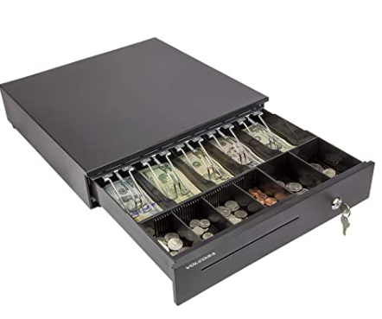
Guess the Value and Category

Slide 131
Guess the Value& Category

Slide 132
Values
1. Camera ($2500)
74 = Photographic/Optical Equipment
2. Ring Set ($1,200)
17 = Jewelry/Precious Metals/Gems
3. Couch ($886)
16 = Household Goods
4. Drill Combo ($333)
36 = Tools
5. Schwinn Cruiser ($320)
04 = Bicycles
6. Lawnmower ($265)
68 = Lawn/Yard/Garden Equipment

Slide 133
Values
7. Xbox Elite Controller ($150)
07 = Computer hardware/software
8. Golden Knights Jersey ($125)
06 = Clothes/Furs
9. Purse ($105) + Fanny Pack ($11)
Combine these two since they fall under the 25 = Purses/Handbags/Wallets category.
10. Bob Ross Oil Paint Set ($75) + Cash Register ($64)
77 = Other since the values of these two items individually are less than the values of the other items.

Slide 134
Enter all known offender information in the “Offenders” section.
If there is any unknown information, select “Unknown” for that field.
Select “Add an Unknown Offender” if no information about the offender is known.
Go straight to the victim tab if the offender is not known.
Click on “Add an Offender” to add additional offenders.

Slide 135
The example shows that an individual was the victim of this incident.
Not every victim has to be connected to every offense.
This example has 1 offense and 1 victim so it is all linked together.

Slide 136
The arrest information is added in this section.
If there was no arrest hit “Finish” to complete reporting the incident.
In this example there was an arrest for the arson.
The arrest was made on the same day of the incident.
Select “Finish” when you are done reporting the arrestee.
Notes:
O = On-View Arrest (apprehension without a warrant or previous incident report) S = Summoned/Cited (not taken into custody) T = Taken Into Custody (based on a warrant and/or previously submitted incident report)

Slide 137
Any Questions??

Slide 141
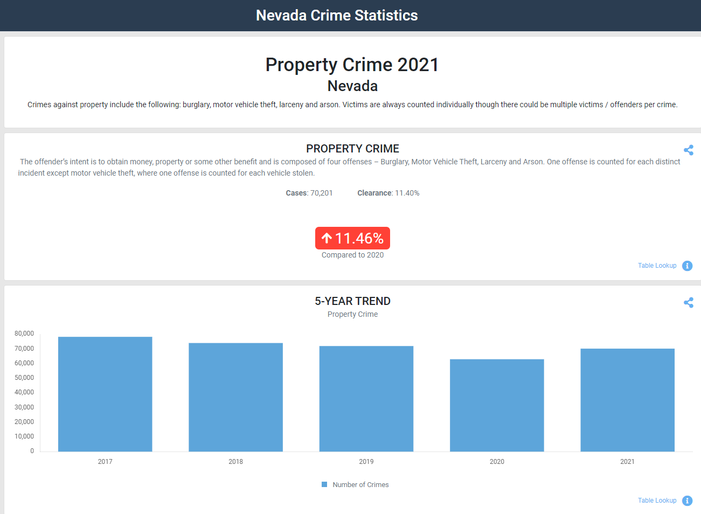
How to view All Reports in TOPS
Select any jurisdiction, year, and theme and proceed to viewing the selected reports.
Click on the blue “Table Lookup” hyperlink on any of the graphs (bottom right of each section).

Slide 142
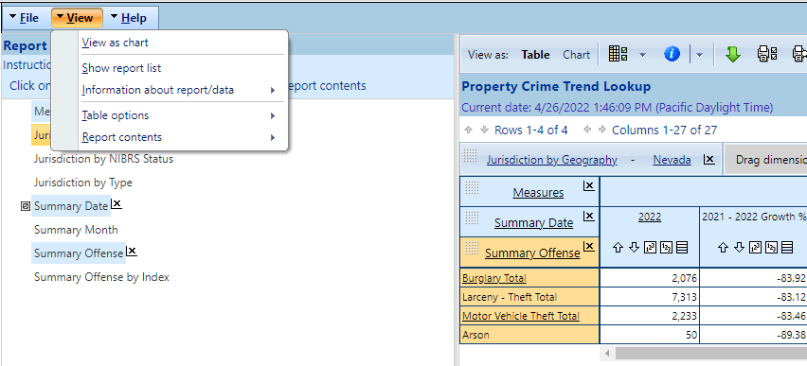
How to view All Reports in TOPS Continued
Click on the “View” dropdown and select “Show report list”.
This will lead to a complete list of reports that are available in TOPS.

Slide 143
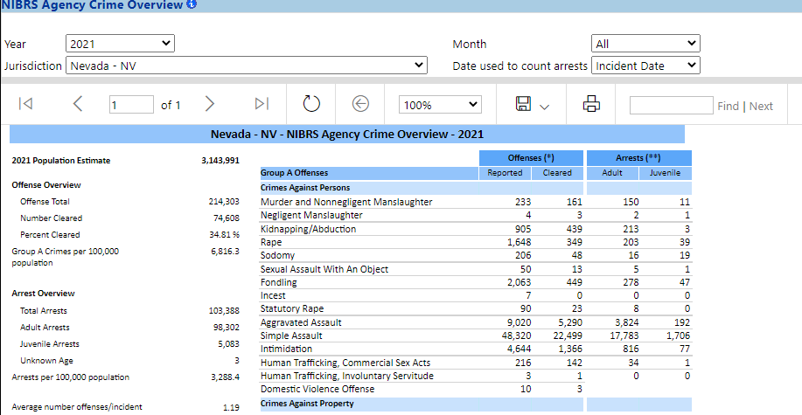
NIBRS Agency Crime Overview Report
Under “Standard NIBRS Reports” is the “NIBRS Agency Crime Overview” report.
This report will show what an agency has reported for a particular month and/or year.

Slide 144
Rac/arac information

Slide 145
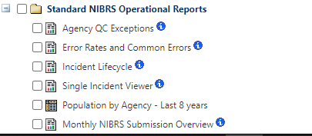
Error Rate and Common Errors Report
Sign into the reporting site on the production website to get to the full list of reports.
Scroll to the bottom of the report list to find the “Error Rate and Common Errors Report” located under “Standard NIBRS Operational Reports”.

Slide 146
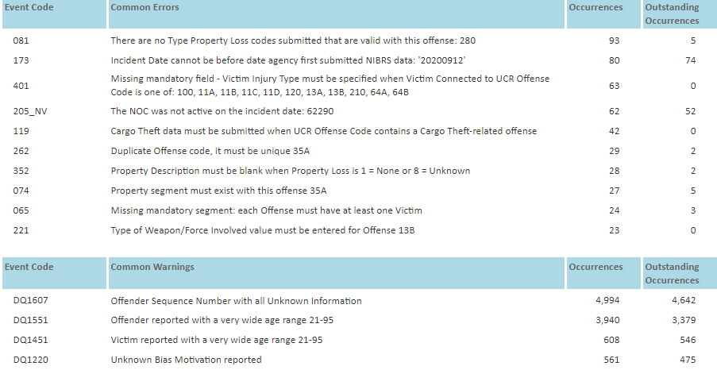
Error Rate and Common Errors Report
A list of warnings and errors will appear.
Can filter by month or set a time range.
“Occurrences” is the number of times that the error or warning occurred.
“Outstanding Occurrences” are the number of occurrences that have not been fixed.

Slide 147
Error Rate and Common Errors Report
Deleting an incident from a new RMS does not fix the outstanding occurrence.
This file saw a reduction of the error rate since two incidents were removed.
Those two incidents should’ve been fixed not removed.

Slide 148
NRS vs. NIBRS Definitions
Nevada Revised Statute definitions can differ from NIBRS definitions.
The mapping done by the NOC team allows for proper NIBRS reporting.
Examples of the NRS and NIBRS definitions are on the next 2 slides.

Slide 149
Assaults
NRS 200.400 defines battery as “any willful and unlawful use of force or violence upon the person of another.”
The NIBRS definition of assault is “an unlawful attack by one person upon another.”
The NIBRS User Manual has the ways the FBI categorizes assaults (starting on PG17).
When using a battery NOC there will be at least one assault NIBRS code mapped to the NOC.

Slide 150
BURGlary
NRS 205.060 outlines where someone can enter to commit a burglary
NRS states that a tent and motor vehicle can be burglarized.
In NIBRS a tent and motor vehicle are not structures that can be burglarized.
Larceny/Theft offenses would apply to situations where someone unlawfully takes something of value from a tent and/or motor vehicle.

Slide 151
Common Language

Slide 154
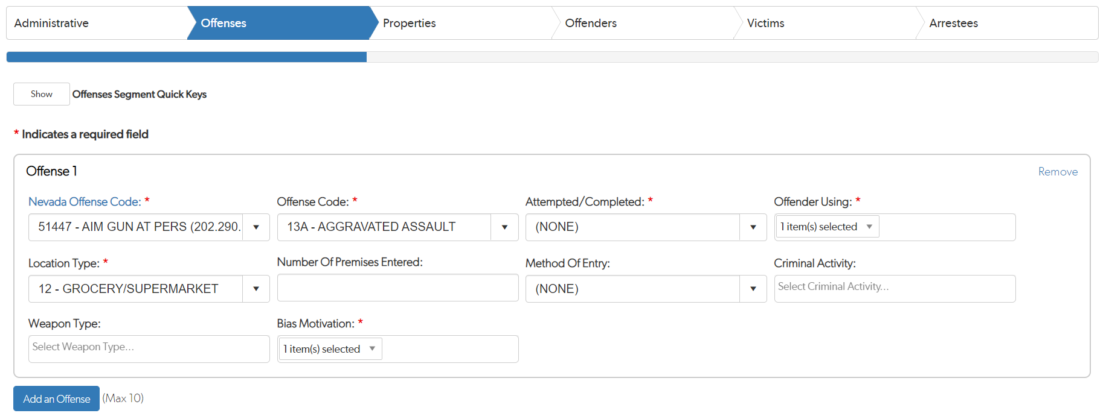
Common Language Cont.
All three of these incidents involved a shooting at a grocery store.
One state charged the offender with assault second degree, one charged with attempted murder, and the third charged with first-degree assault.
In NIBRS the FBI would receive an aggravated assault (plus other offenses if applicable) for the shootings from each state.

